Slide 1
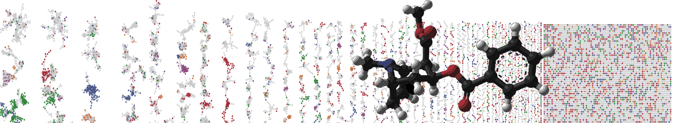


MASST – Querying All Public Metabolomics Data
HANDS ON
ENTER AUTHORS HERE
University of California - San Diego

Slide 2
Objectives and Data
Utilize GNPS MASST
Explore Public Data Occurrences

Slide 3
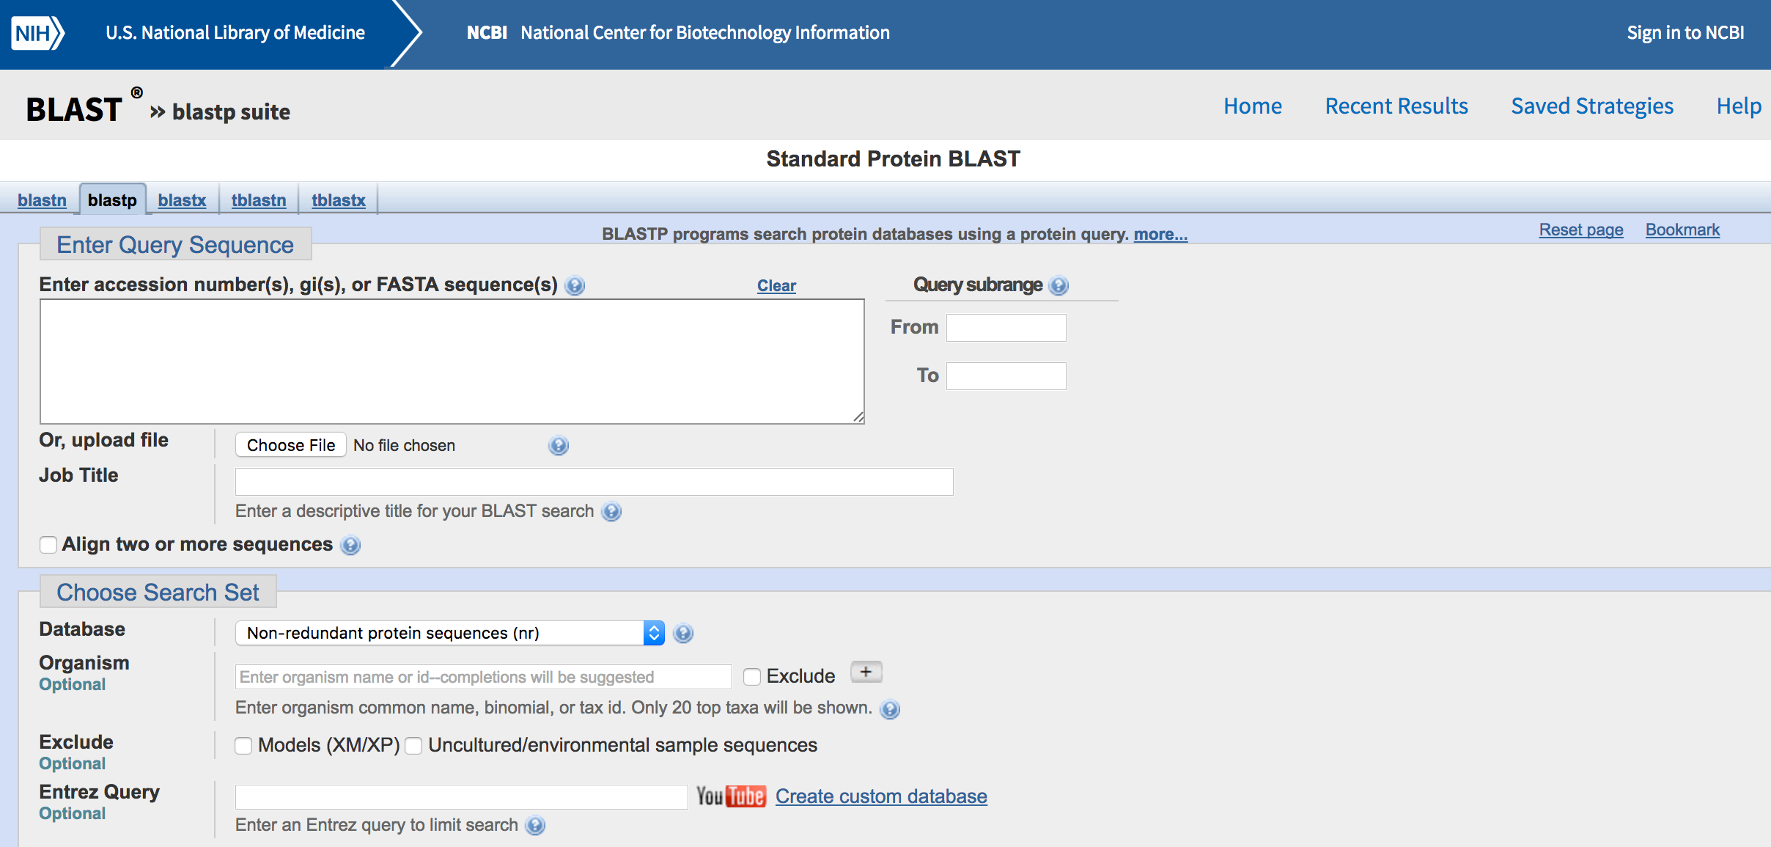
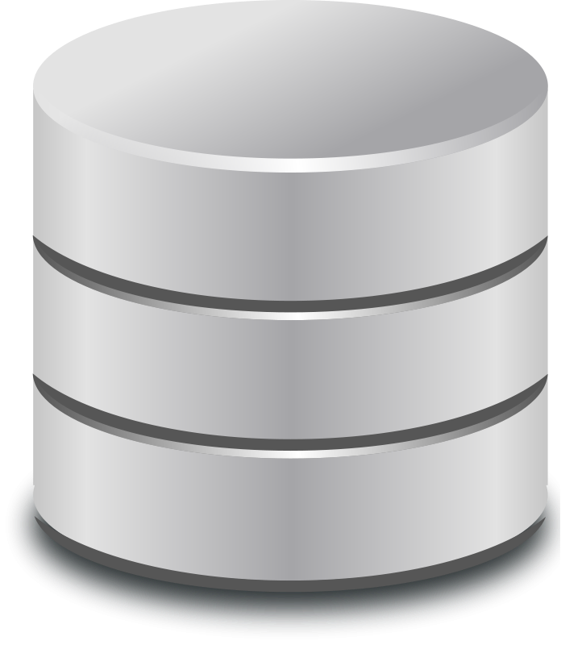
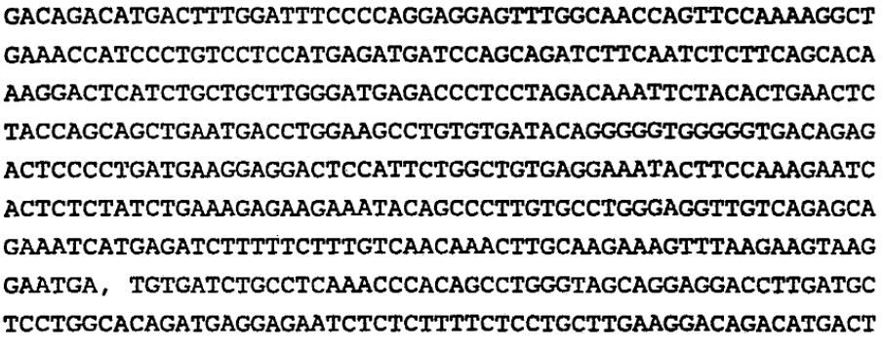

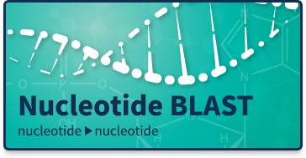
With sequencing we have come to expect the knowledge is accessible and retrievable
Not true for mass spectrometry
Database
Where is this seq.
found? any analogs?
Knowledgebase
Retrieval infrastructure

Slide 4
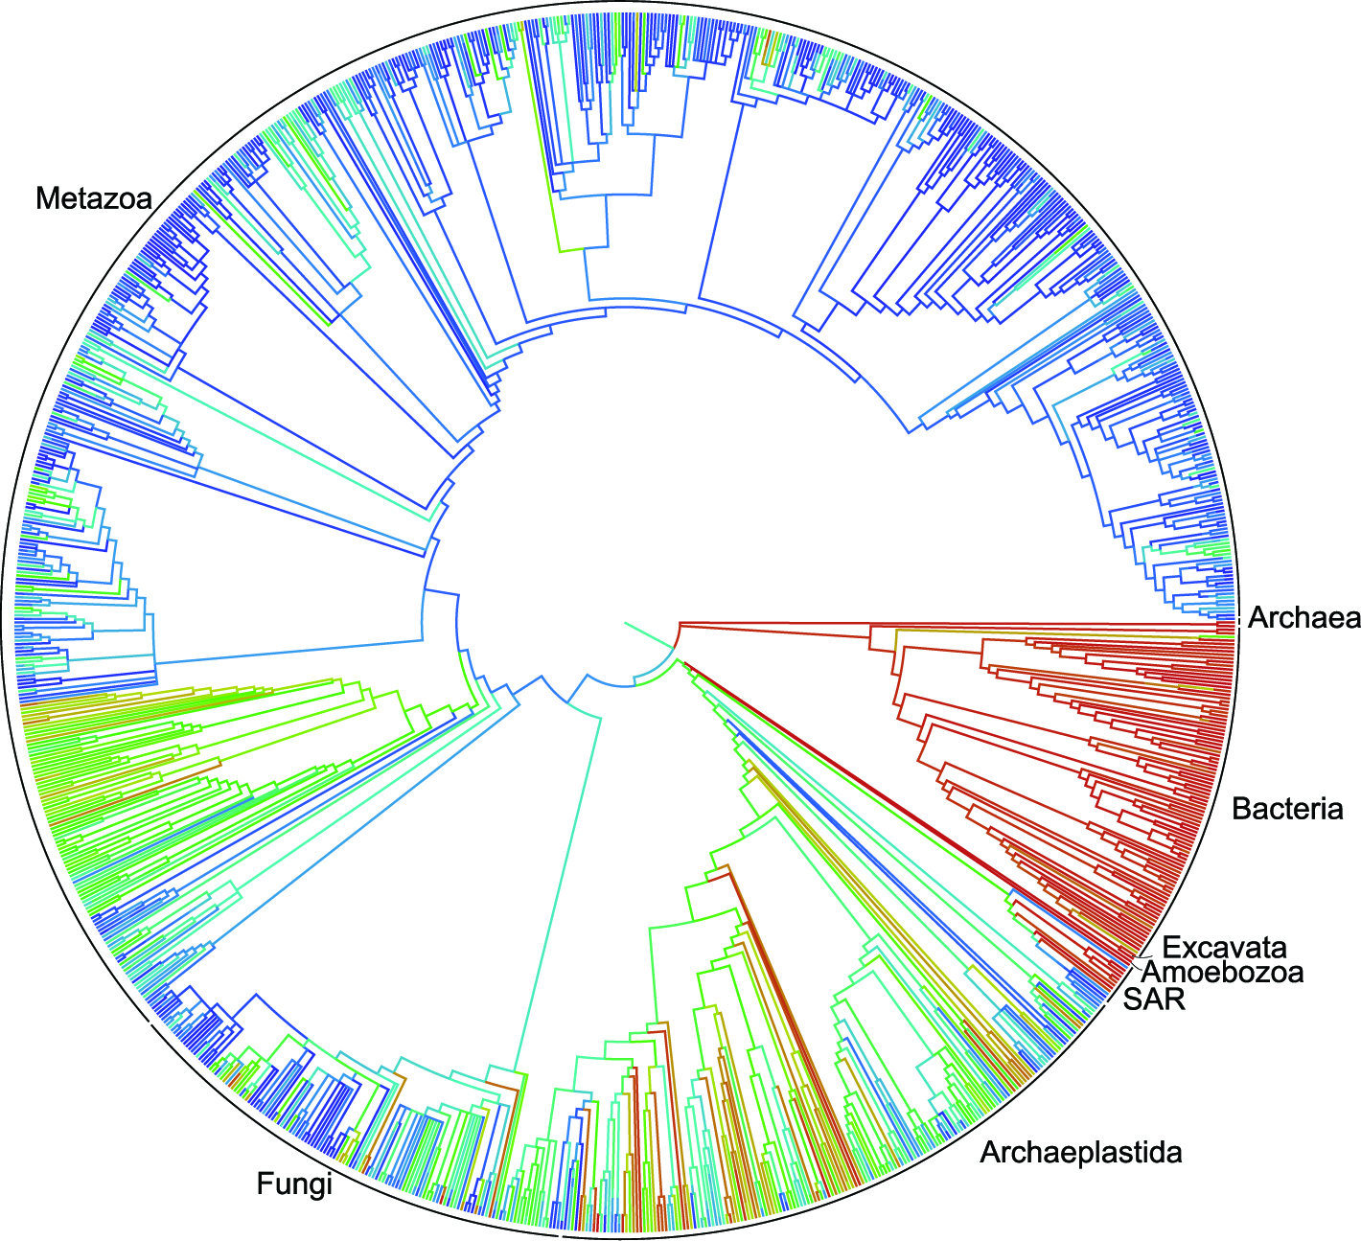
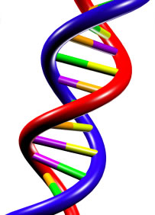
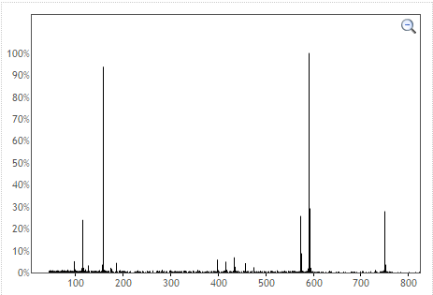

MASST – Mass Spectrometry Search Tool
BLAST
1000+ Datasets
100s Million Spectra
MASST
All Mass Spectrometry
Metabolomics/Natural Products
Datasets

Slide 5
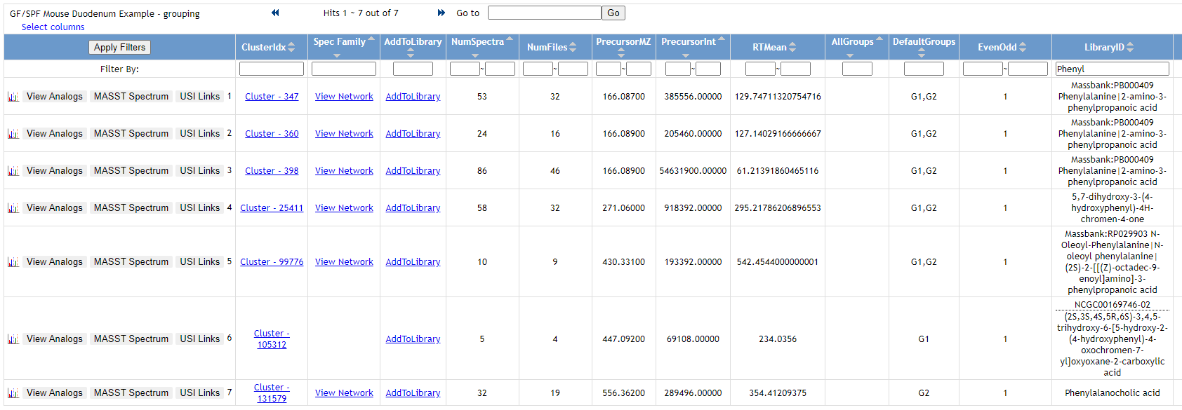
Search Directly From Molecular Networking
Phenyl
Interactive Link

Slide 6
Search Directly From Molecular Networks
Phenyl
Phenylalanocholic Acid MASST Query
Interactive Link

Slide 7
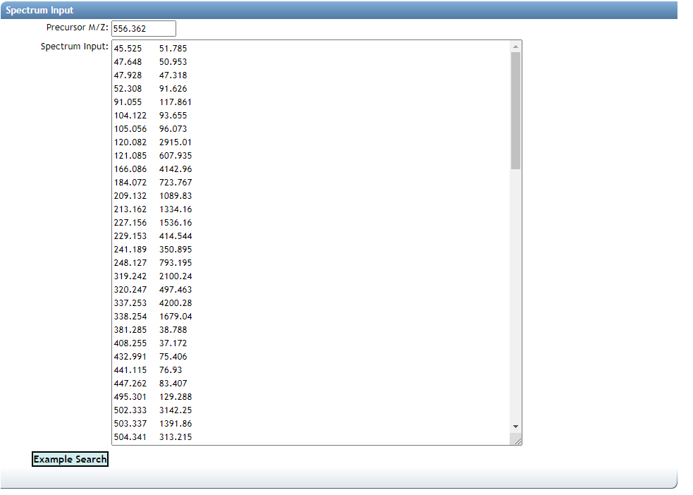
MASST Query Form
Precursor M/Z
Fragment Peaks
Interactive Link

Slide 8
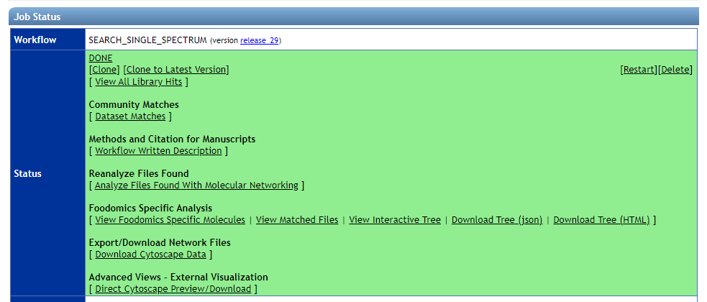
MASST Results
Interactive Links

Slide 9
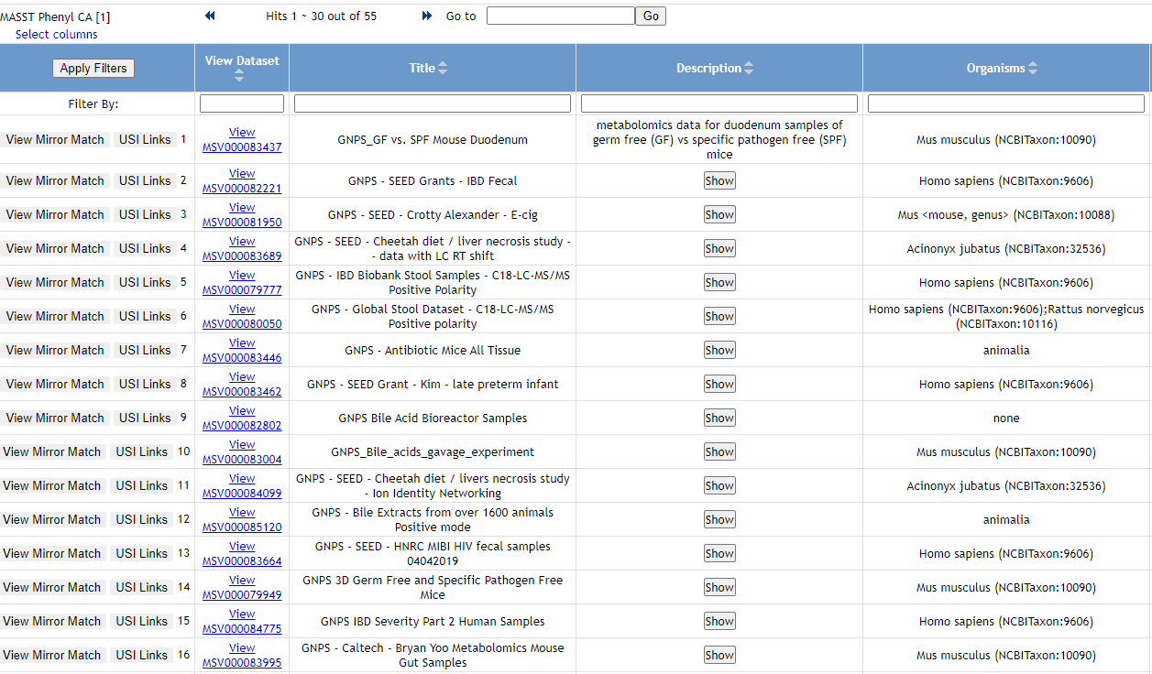
MASST Results – Dataset Occurrences Found
Interactive Links

Slide 10
Questions, Problems or Bugs?
Documentation: https://ccms-ucsd.github.io/GNPSDocumentation/
Forum: https://groups.google.com/forum/#!forum/molecular_networking_bug_reports
PRESENTER NAMES AND EMAILS HERE

